Slide 1
Fundamentals of Communications Engineering
Department of Communications Engineering, College of Engineering, University of Diyala, 2016-2017
Class: Second Year
Instructor: Dr. Montadar Abas Taher
Room: Comm-02
Second Lecture Signals II

Slide 2
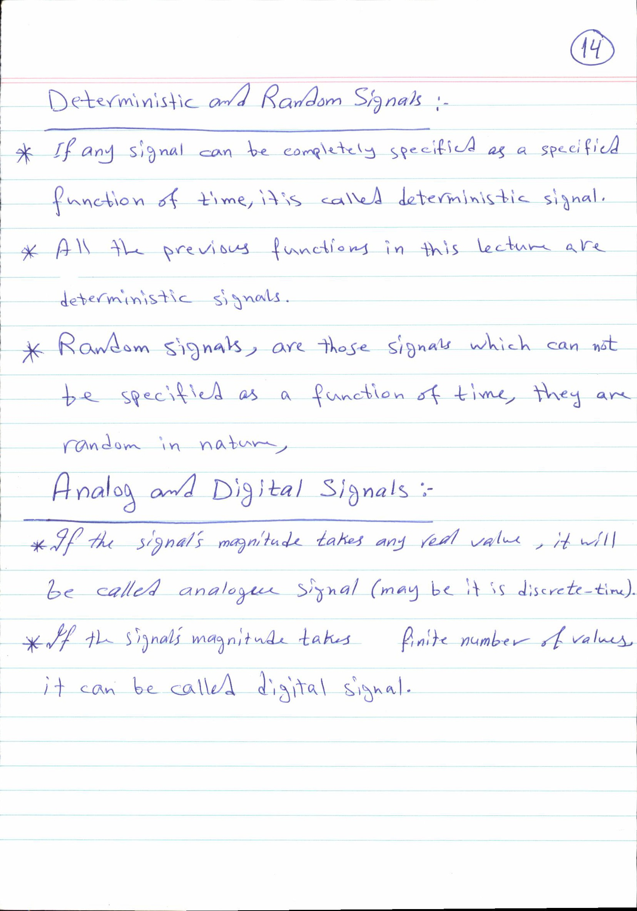

Slide 3
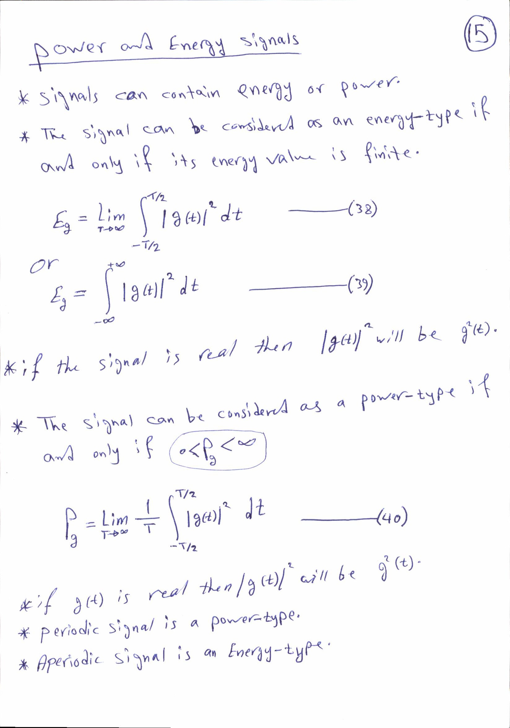

Slide 4
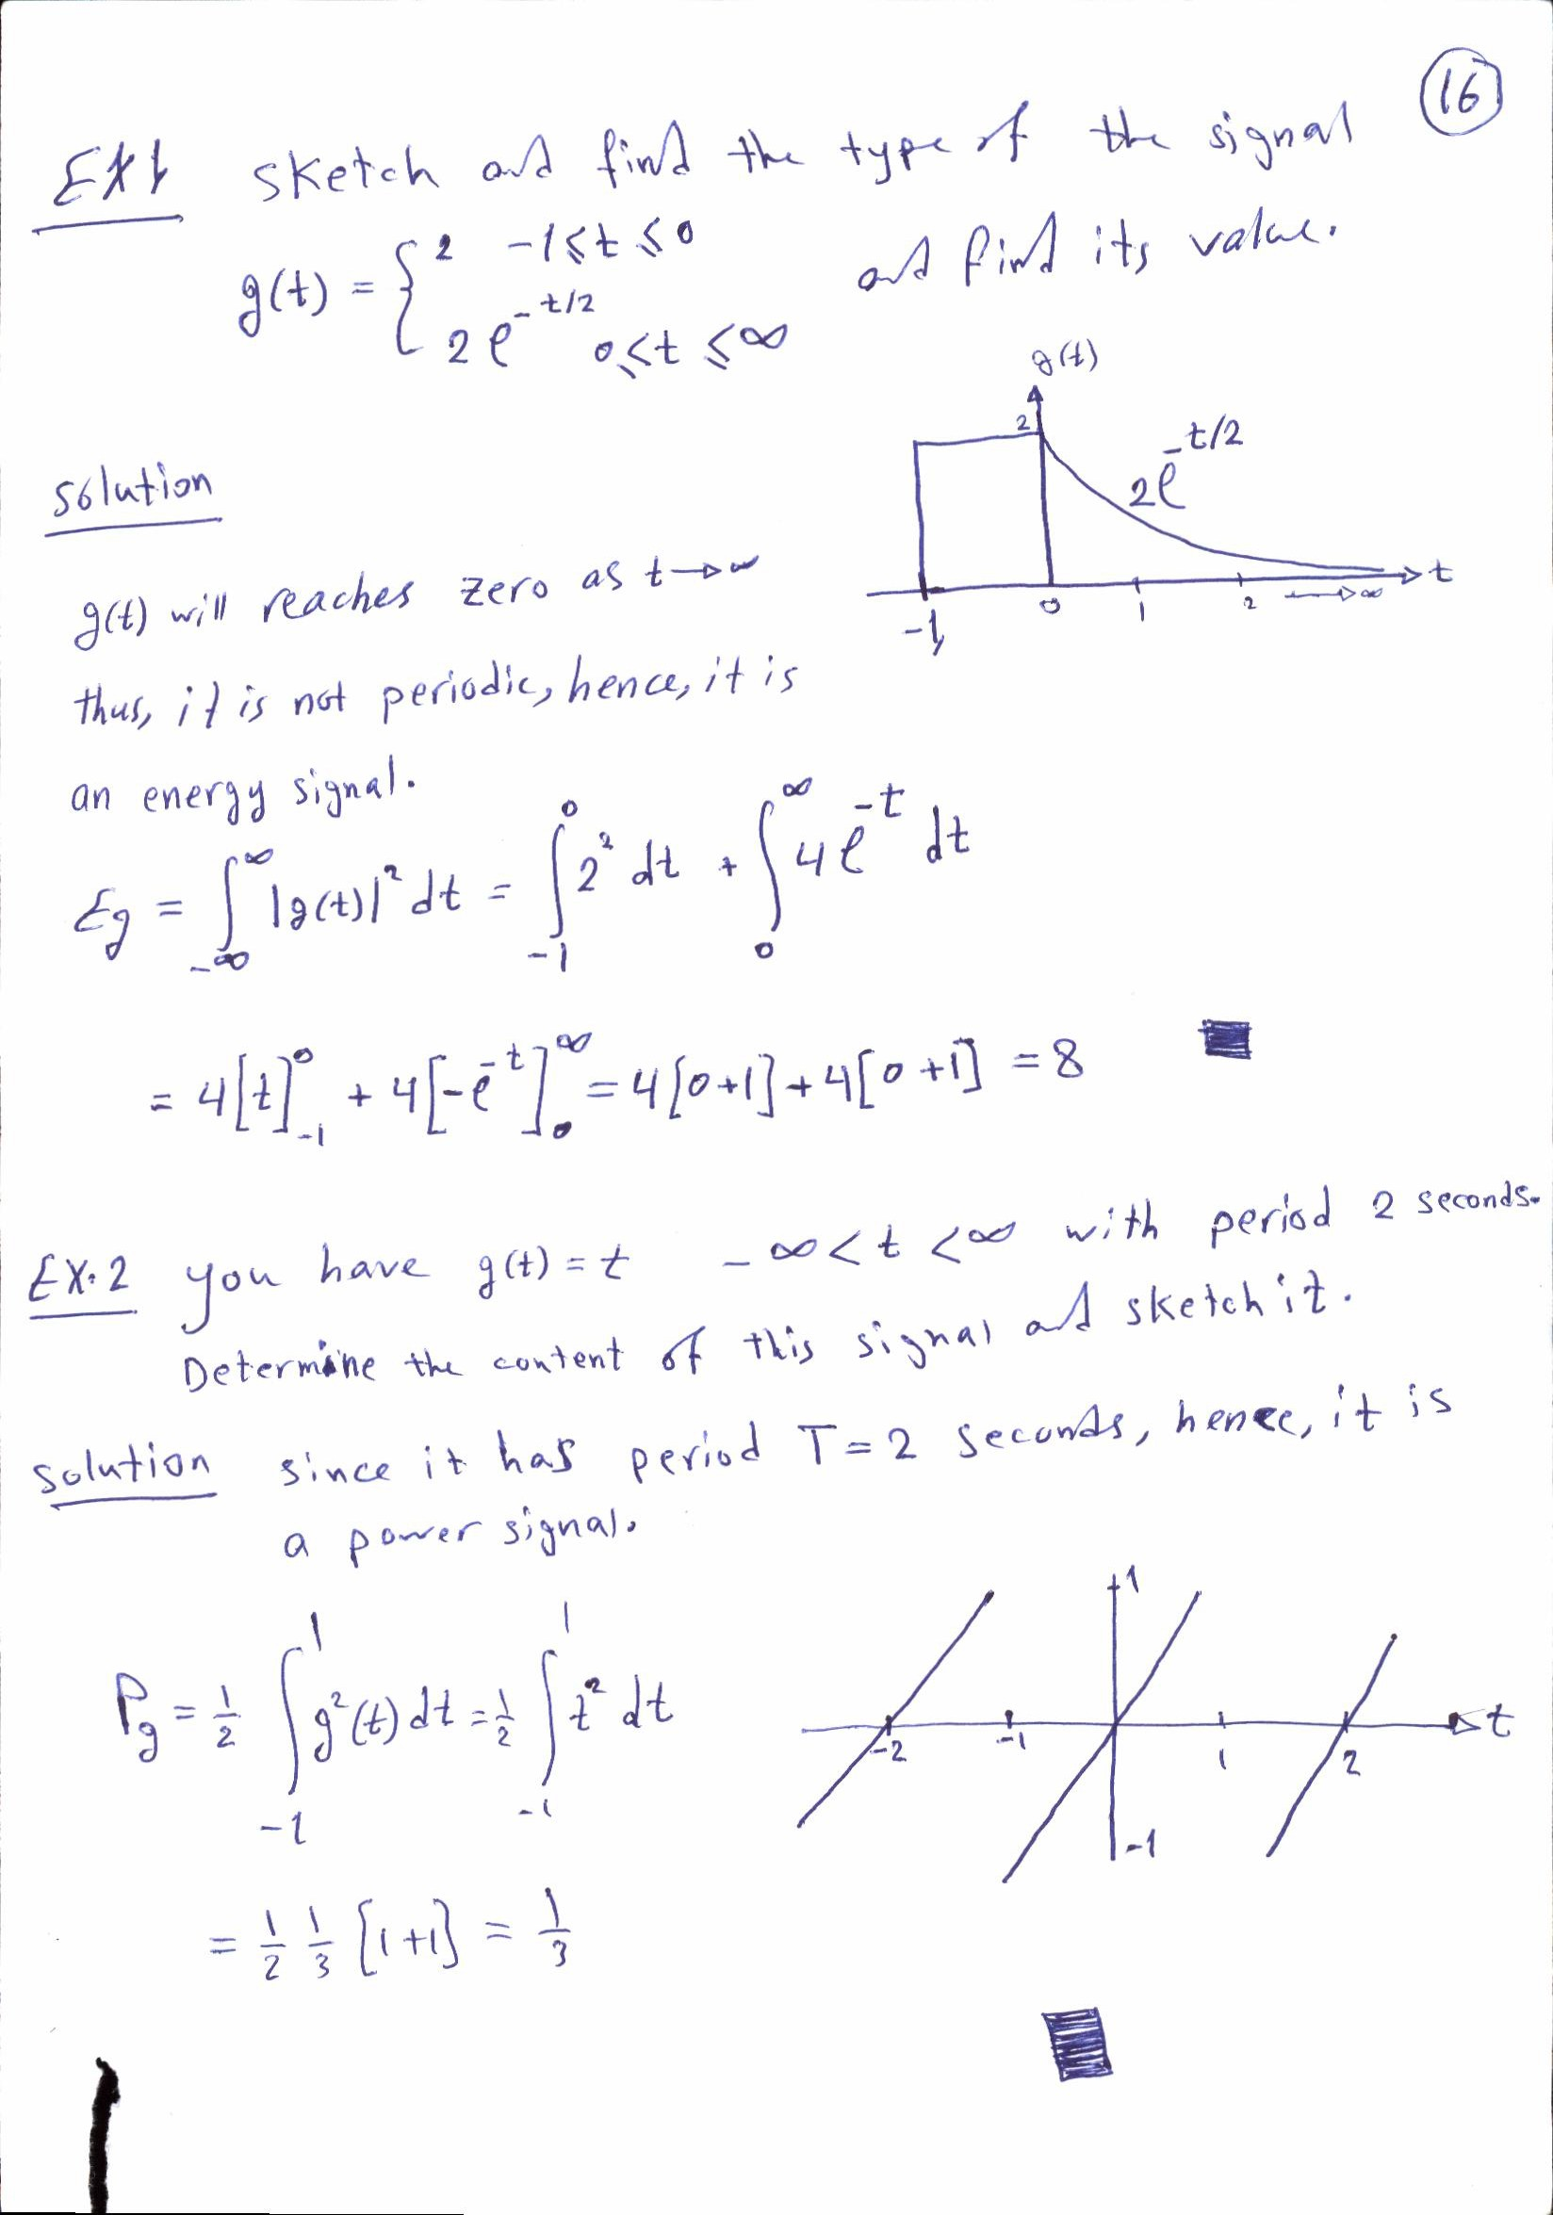

Slide 5
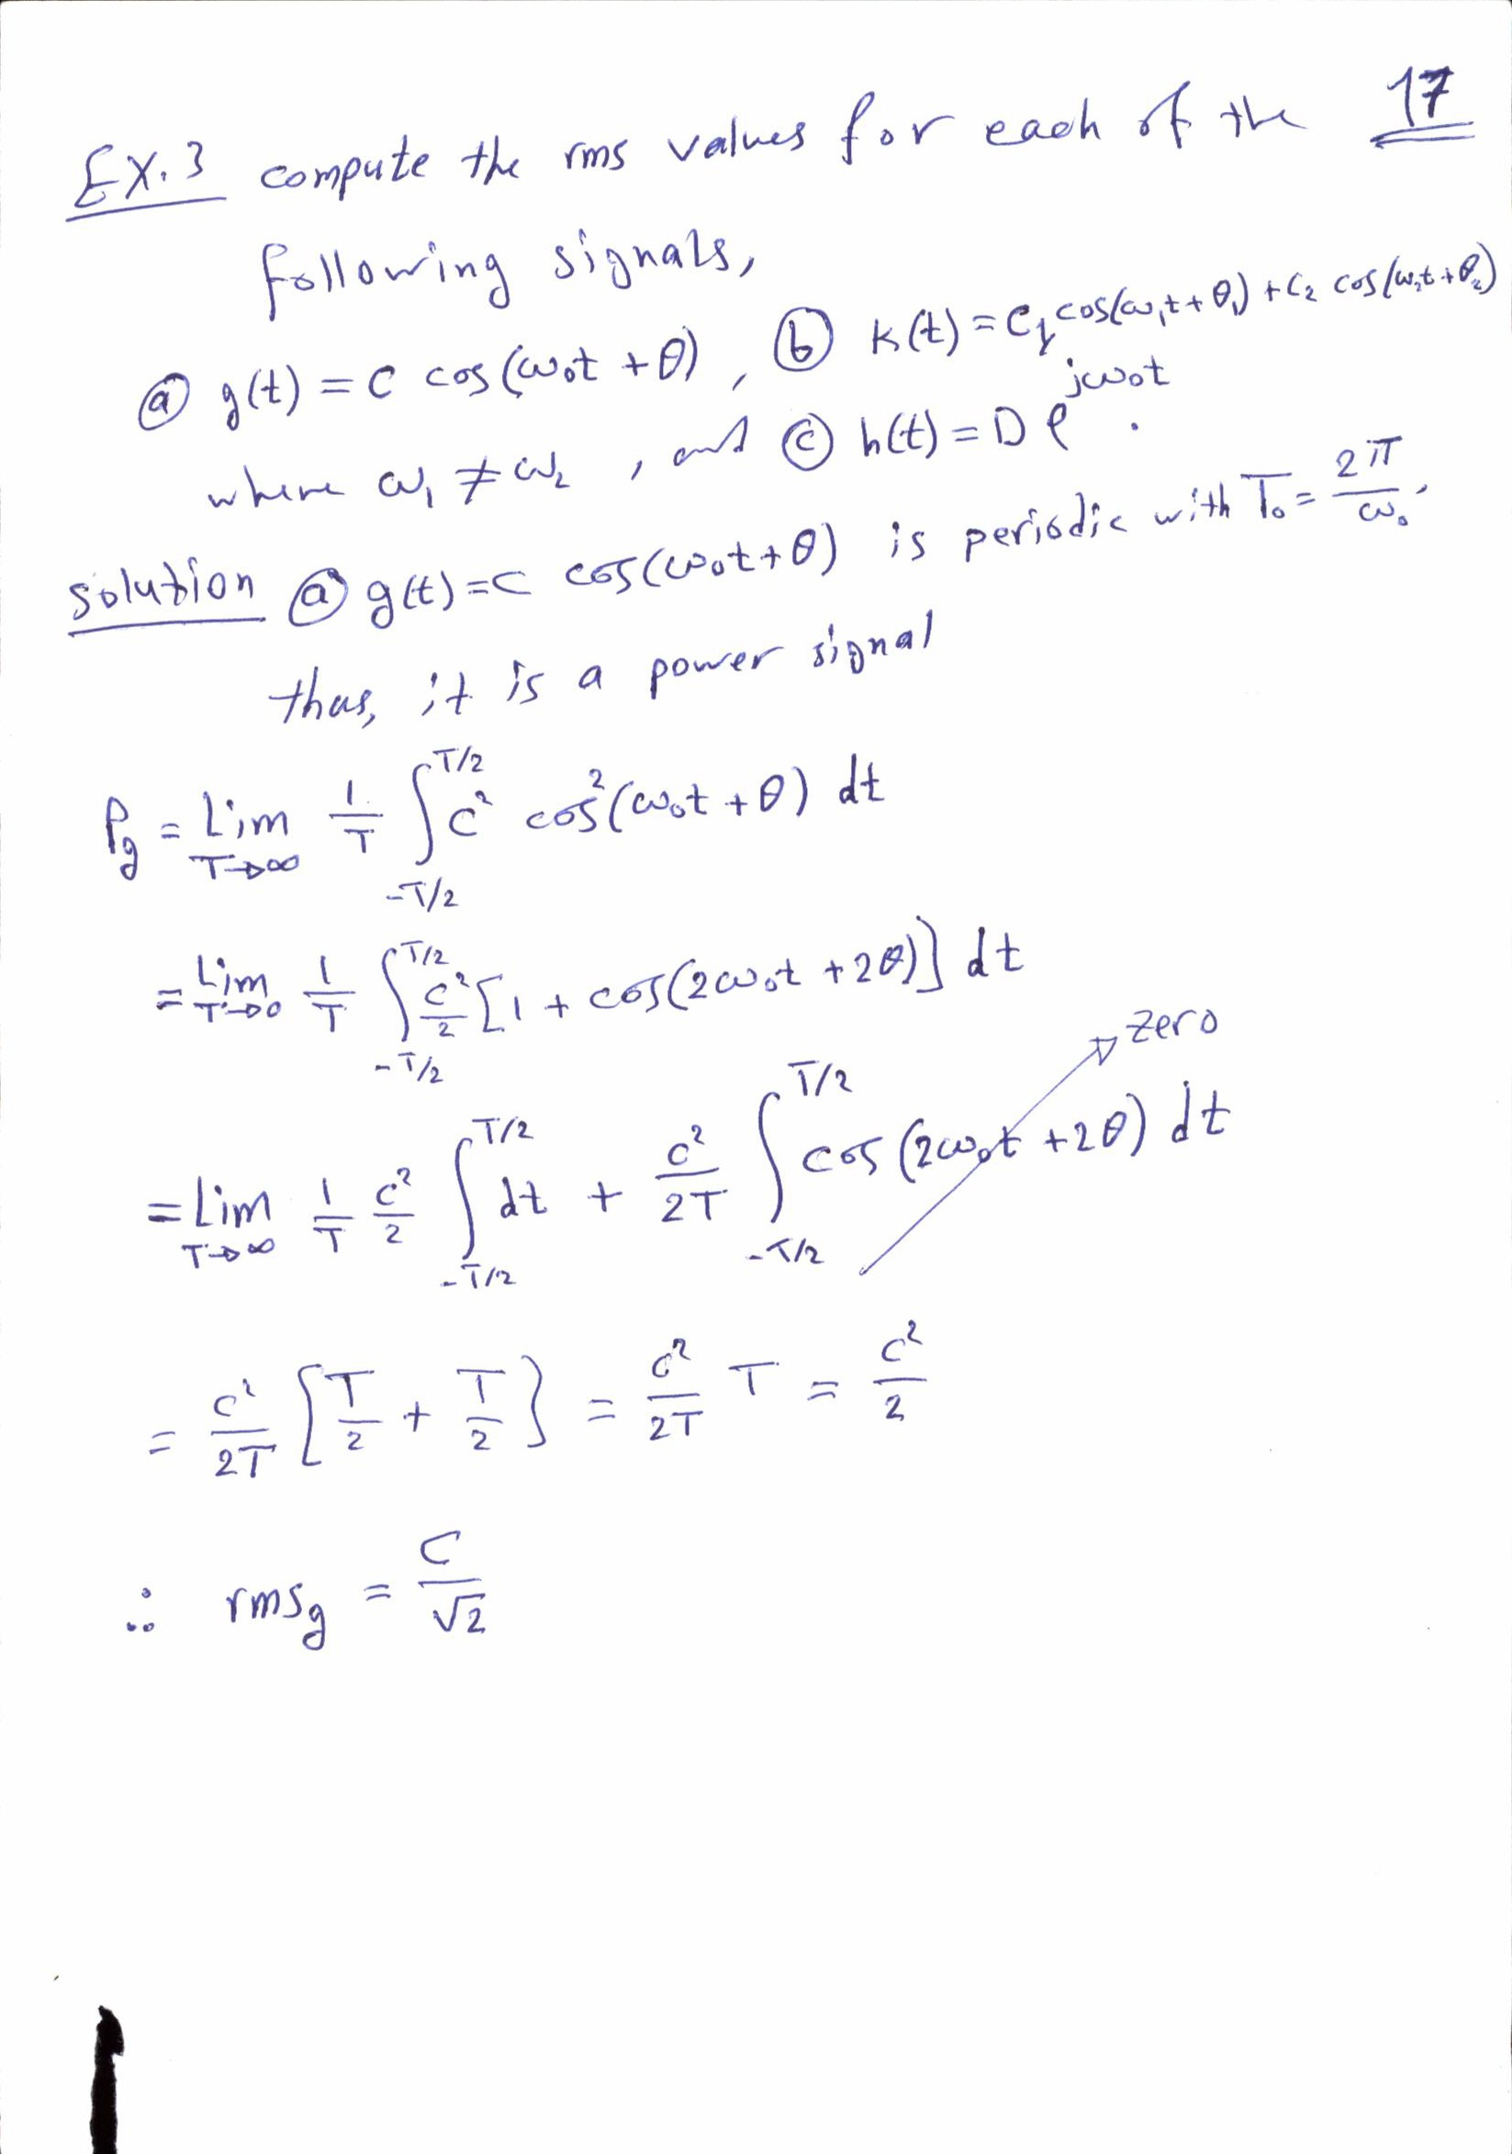

Slide 6
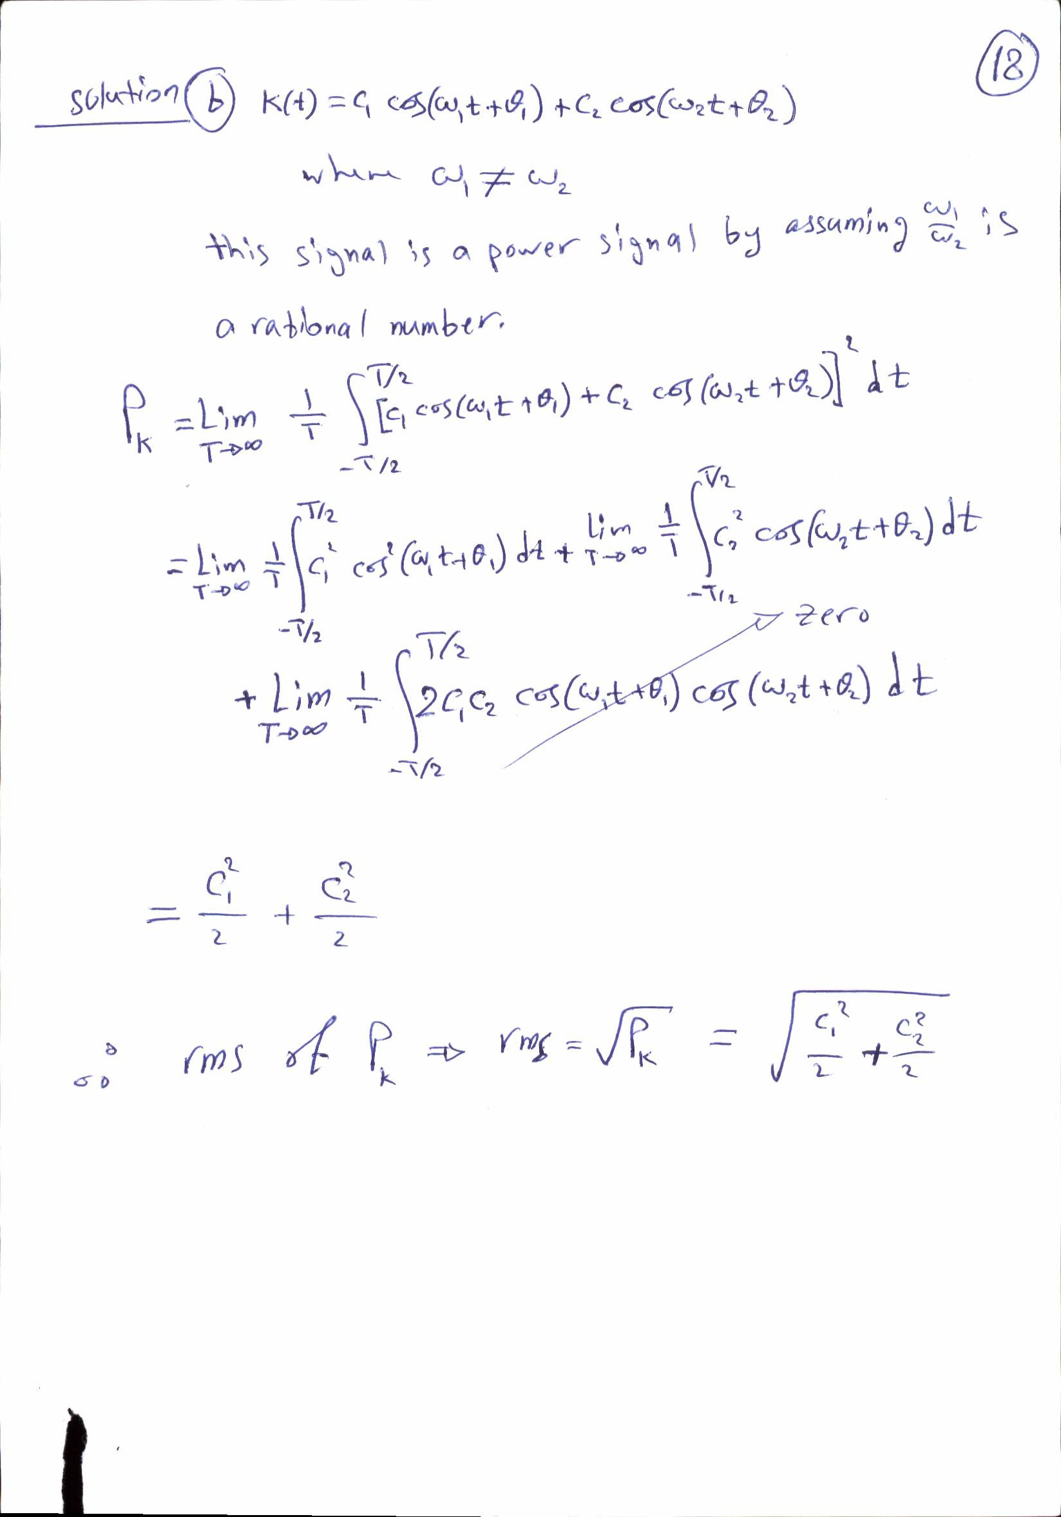

Slide 7
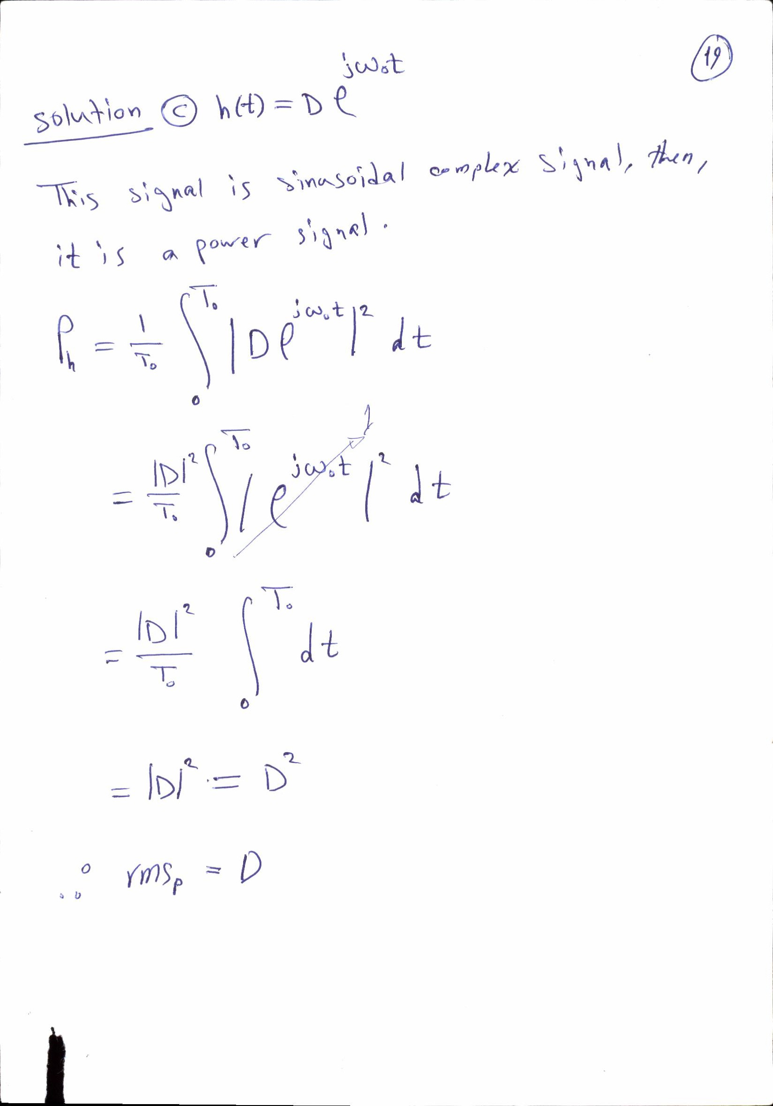

Slide 8
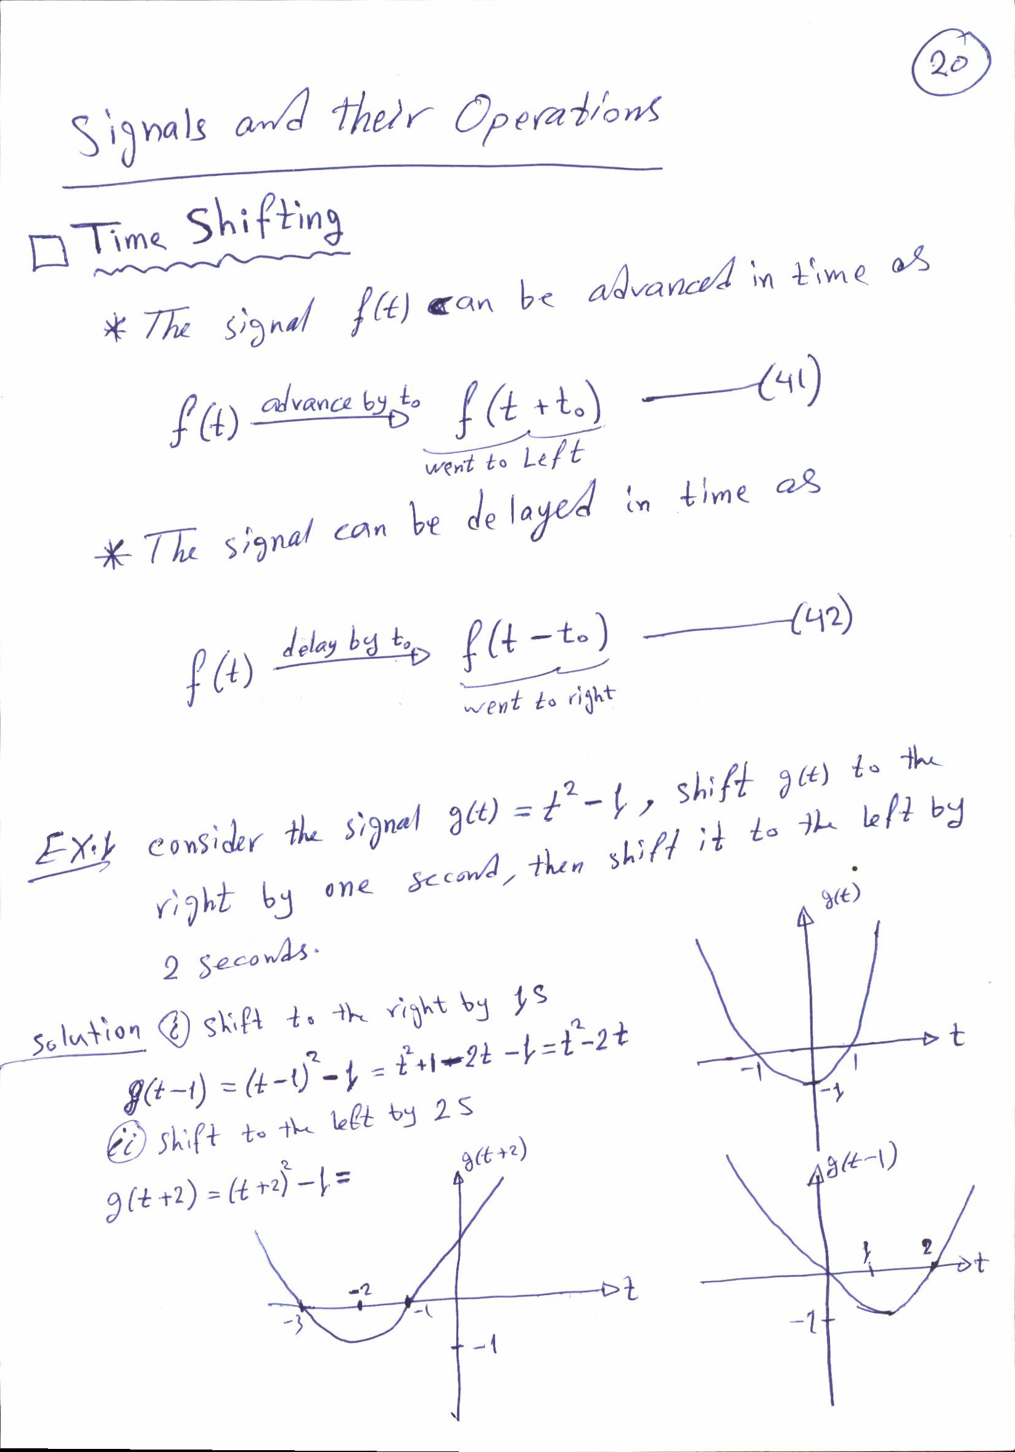

Slide 9
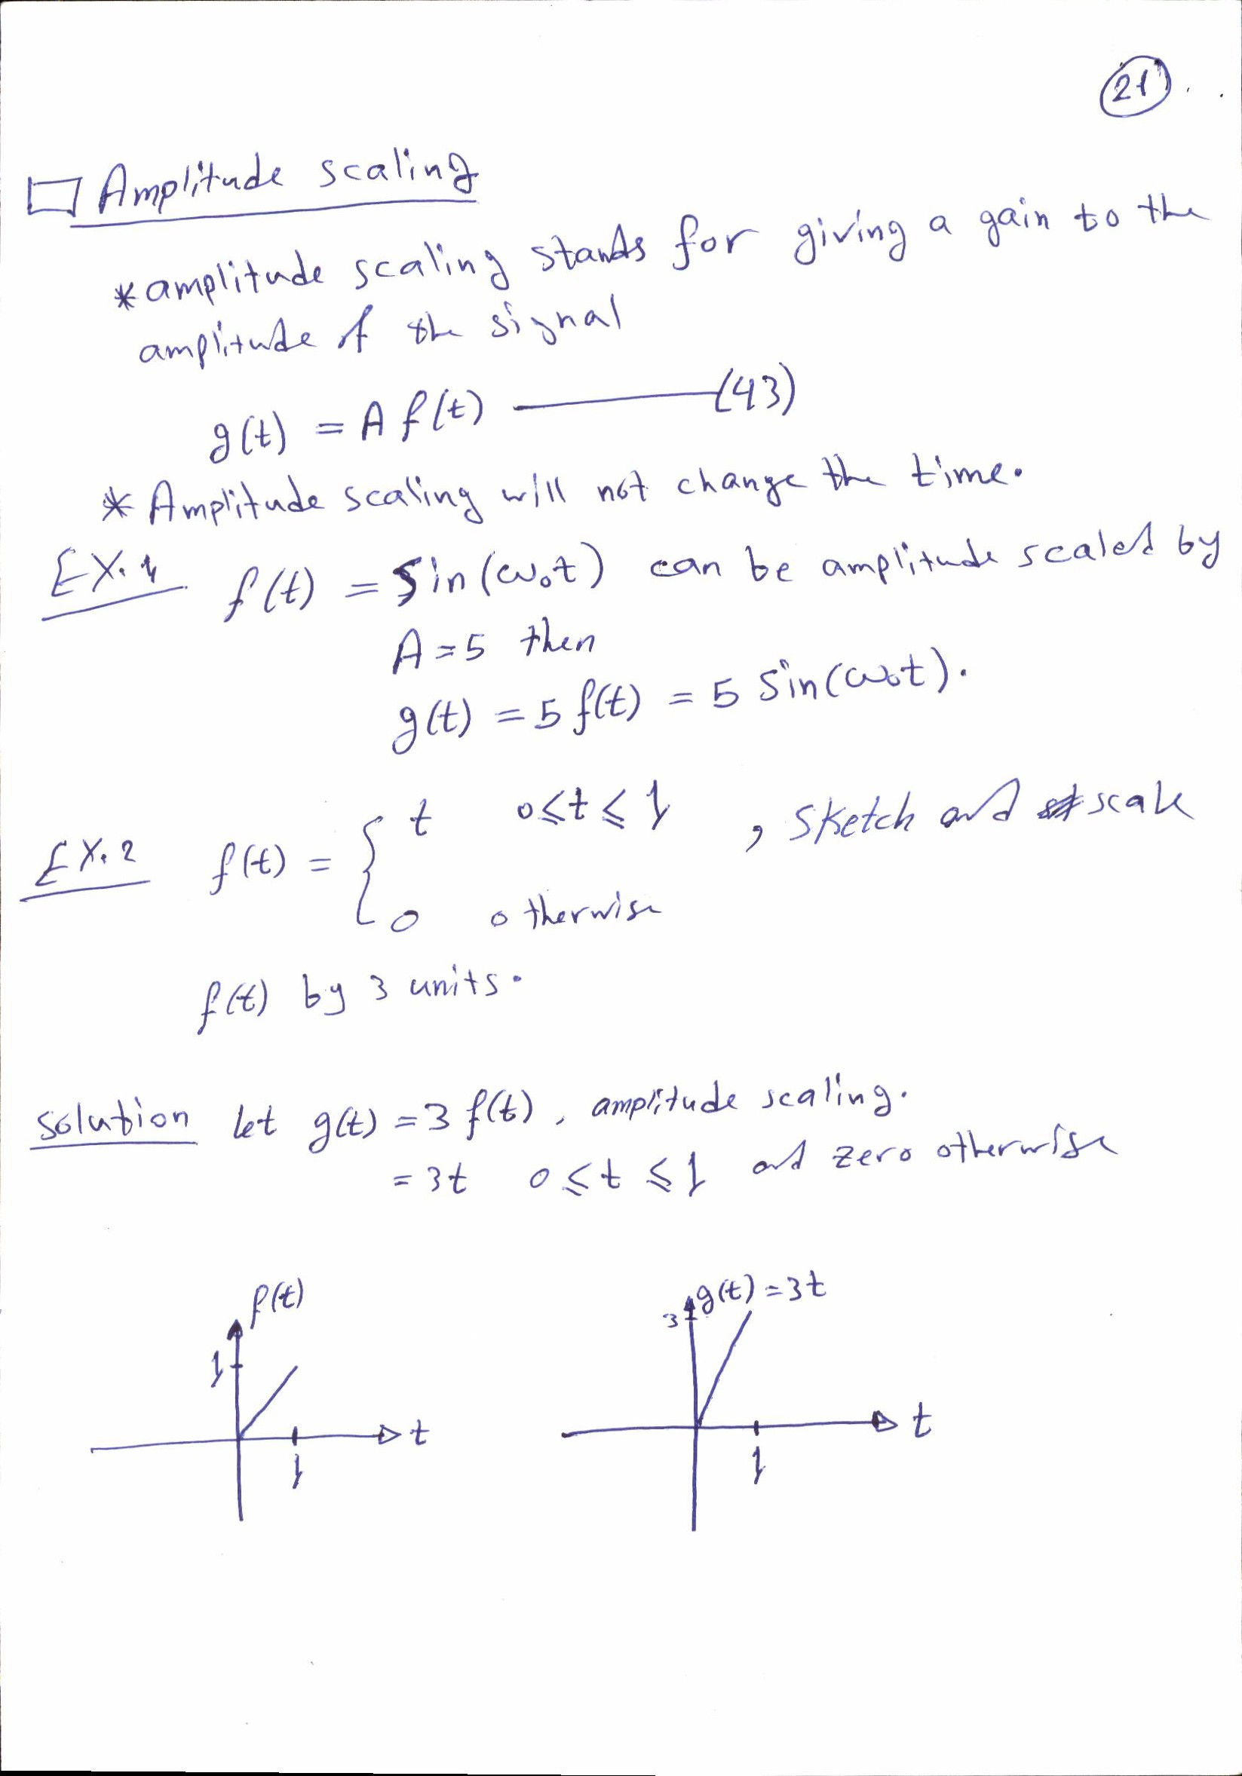

Slide 10
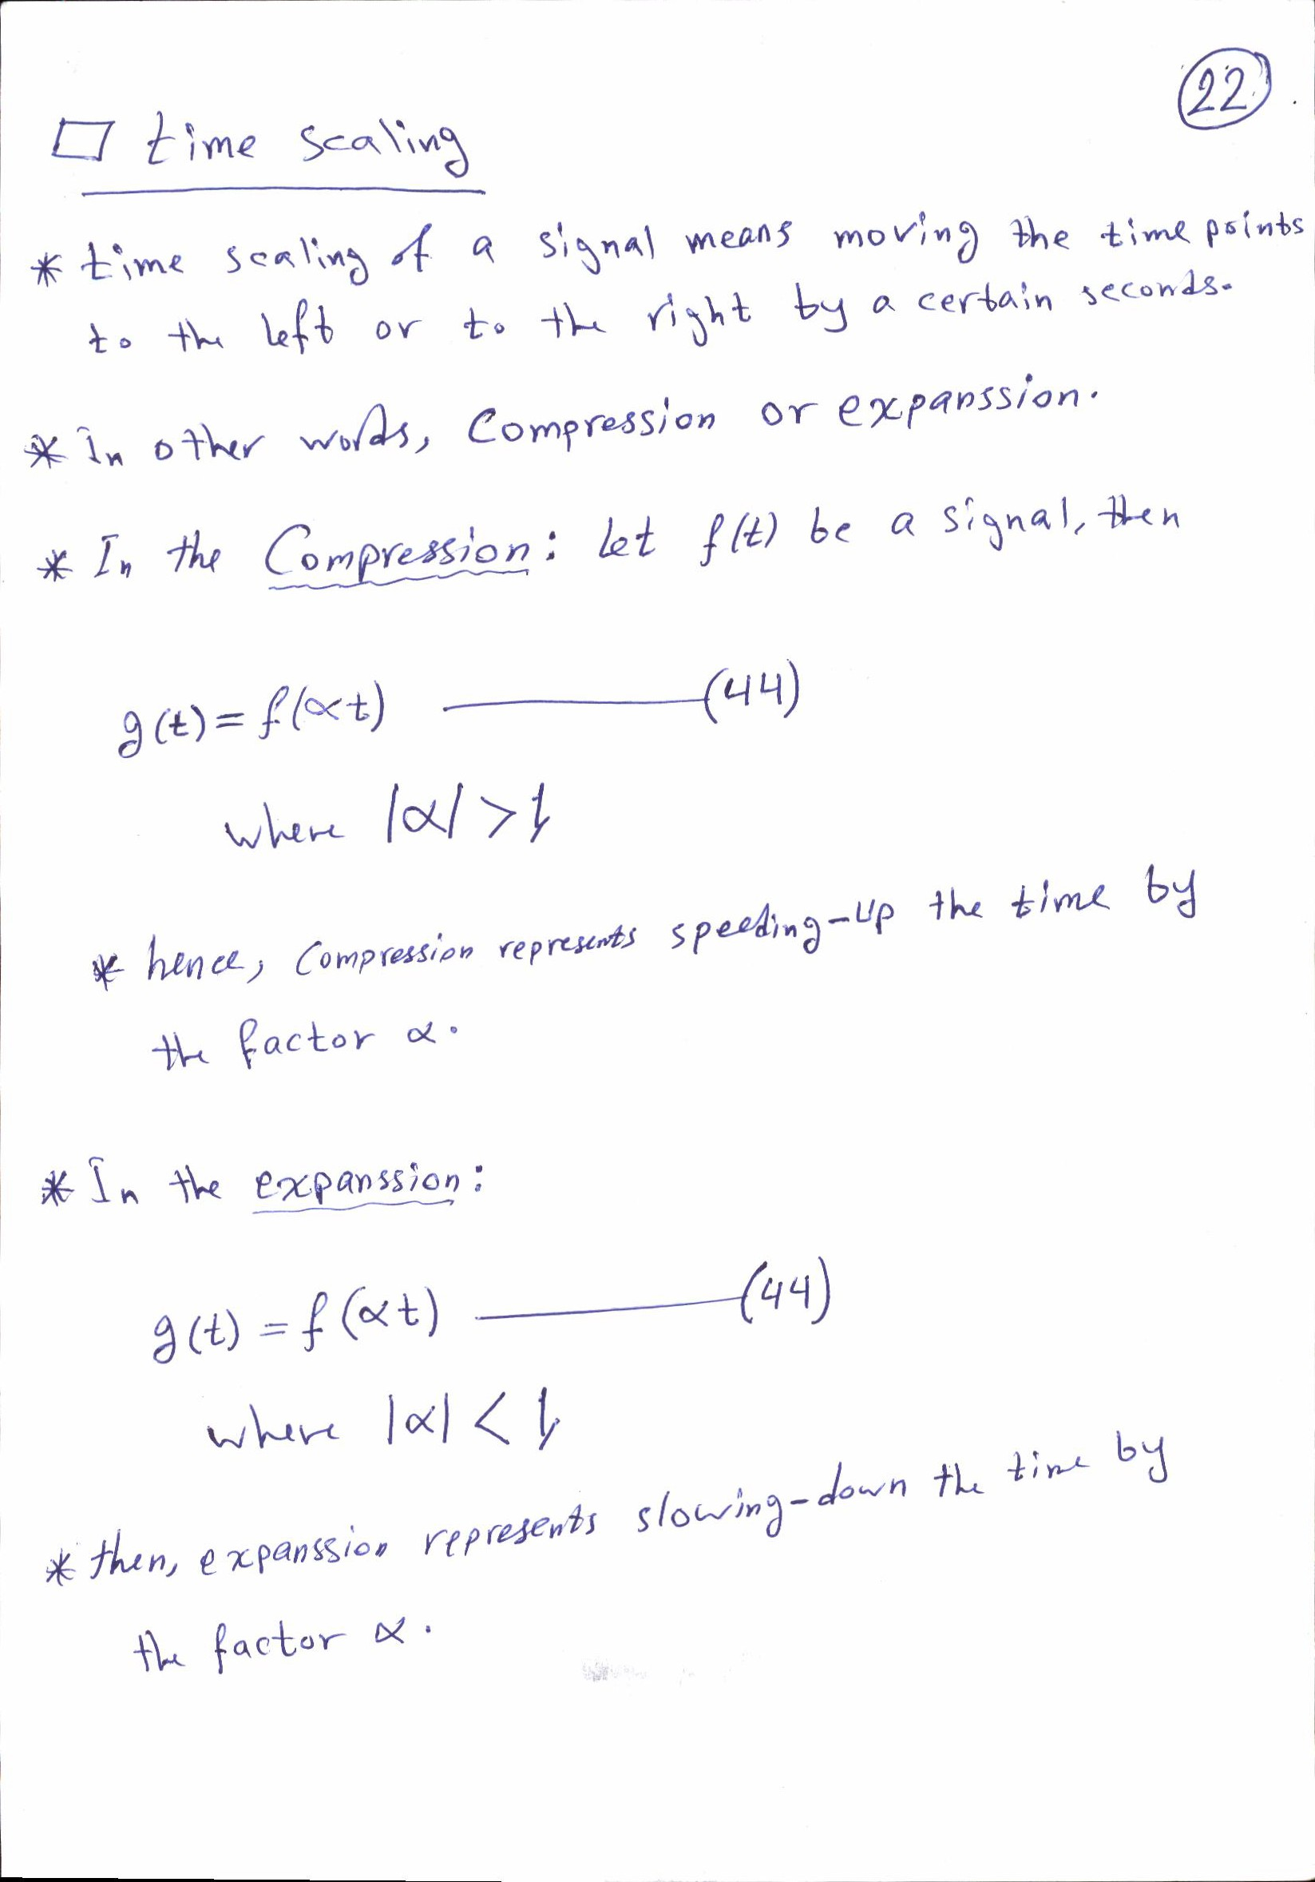

Slide 11
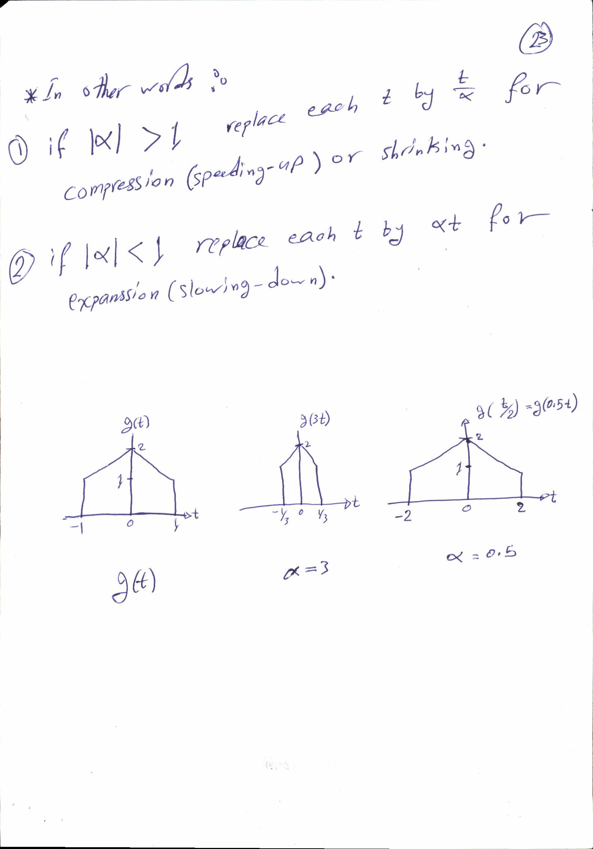

Slide 12
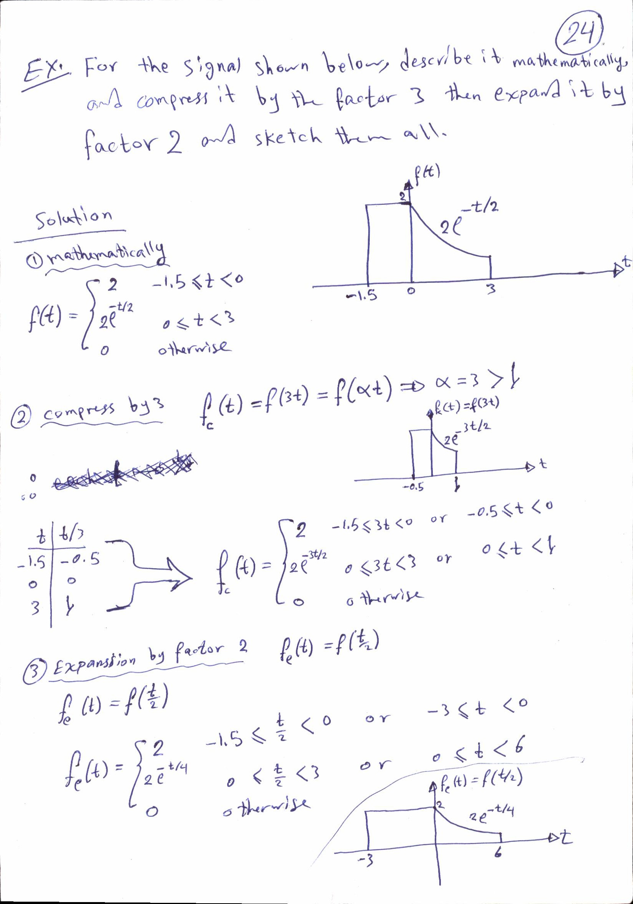

Slide 13
